Slide 1

E-PROJECT THE CAKE WEBSITE

Slide 2
OVERVIEW
1. INTRODUCTION
2. TEAM MEMBER
3. THE TECHNOLOGY WE USED
4. WEBSITE STRUCTURE AND FUNCTIONS

Slide 3
1. INTRODUCTION
In today’s day to day life purchasing of products by visiting stores has become a tough job. As a standing in a queue for making the payment of the product has become difficult for customers. To overcome these difficulties, we are coming up with TheCake.
The purpose of our project is to design, publish and maintain a website for our Cake manufactures. TheCake is the Cake website which helps to choose a wide range of products through your desktop or smartphone rather than visiting the outlets. It is developed using HTML5, CSS3, Javascript which is a basis of almost website, the basic e-commerce functionality in website can be achieved through Javascript. It has been developed to handle dummy procedure for buying to be added and checkout.

Slide 4
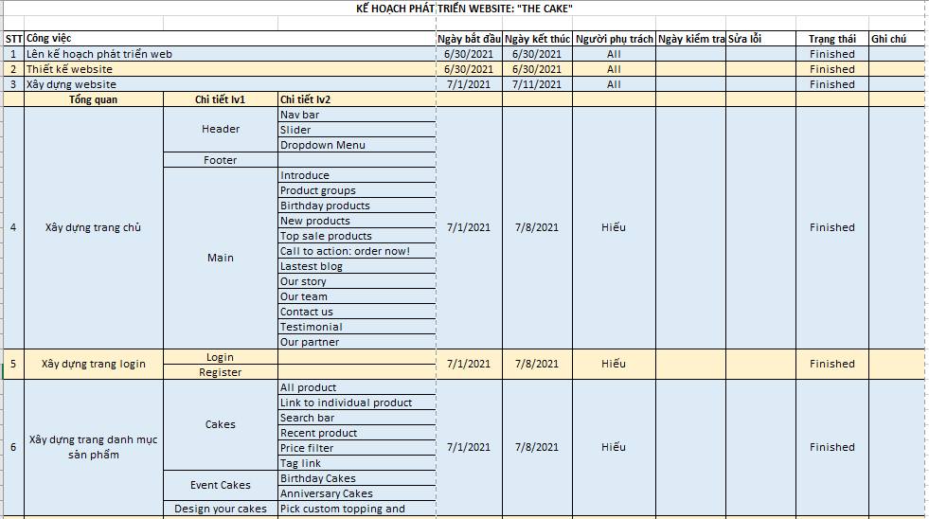

Slide 5
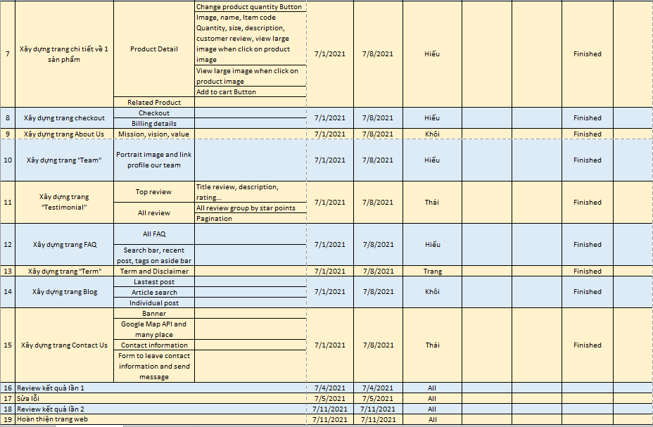

Slide 6


2. TEAM MEMBER
Leader
Hieu Nguyen Cao
Member
Khoi Hoang Sy
Member
Trang Nguyen Mai
Member
Thai Ngo Hong

Slide 7
3. THE TECHNOLOGY WE USED
HTML5
CSS
JAVA SCRIPT
PLUGINS

Slide 8
4. WEBSITE STRUCTURE AND FUNCTIONS
We build total 20 websites: Home, Product, About us, Testimonial, FAQ, Blog, Contact, Checkout, Add to cart…

Slide 9
HOME
Product
About Us
Blog
Contact
About Us
Cakes
Posts
Team
Design your cake
Testimonial
Event Cakes
FAQs
Birthday cake
Anniversary cake
Term

Slide 10
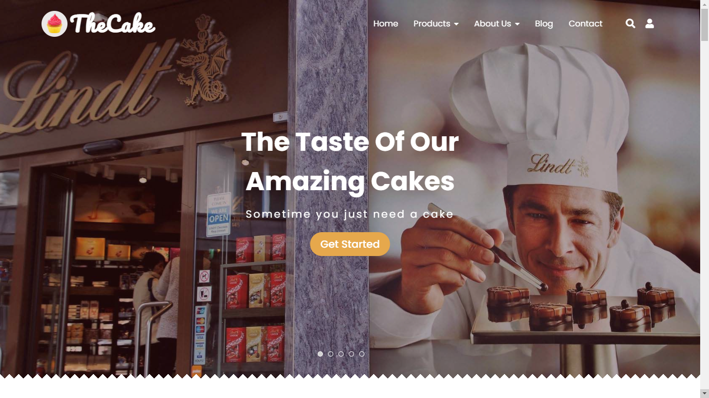
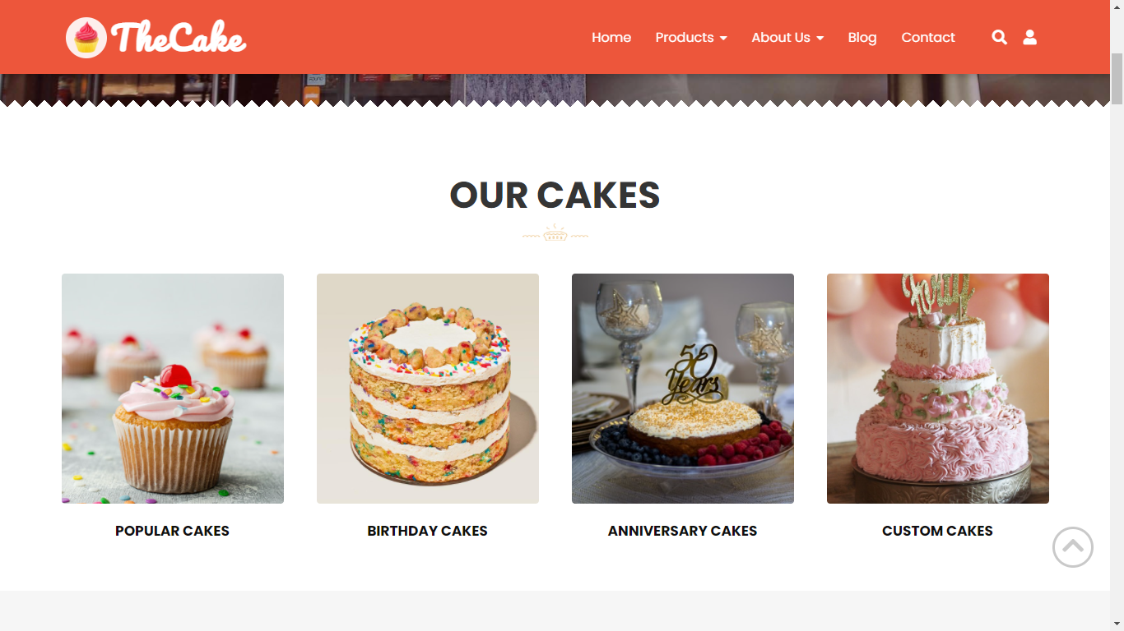
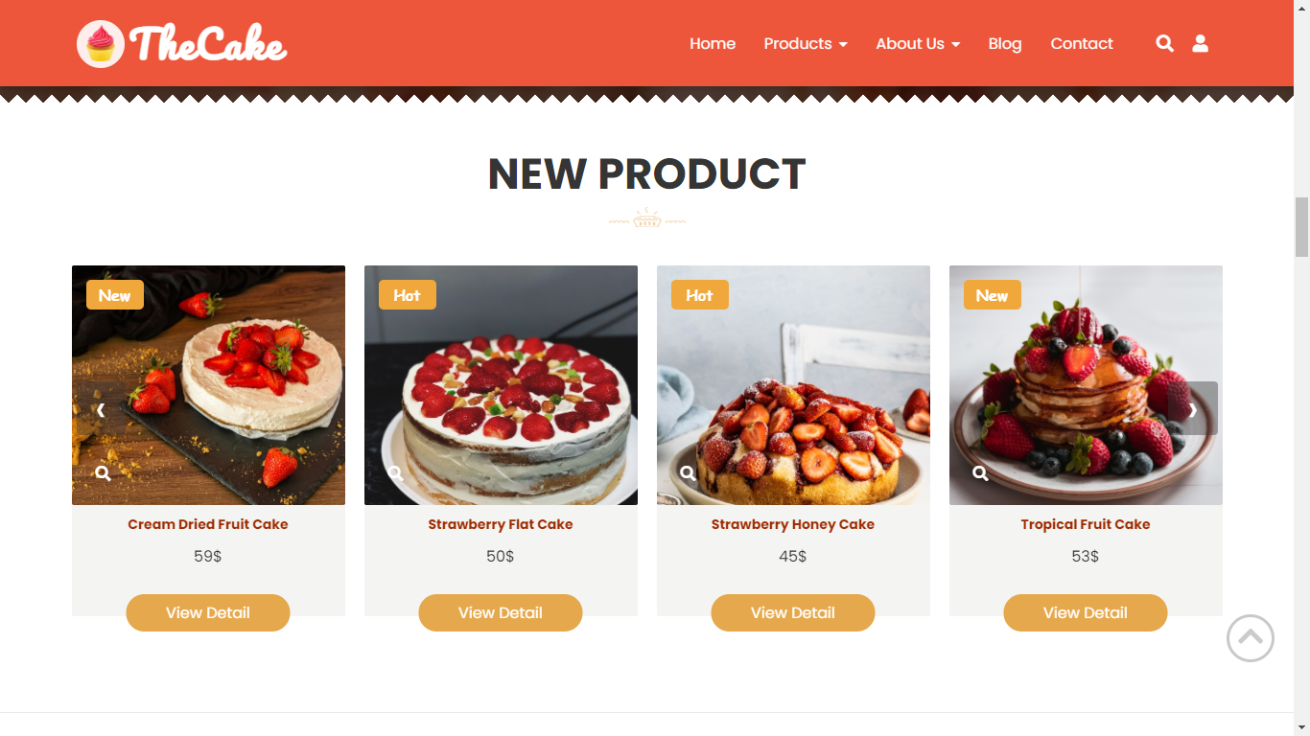
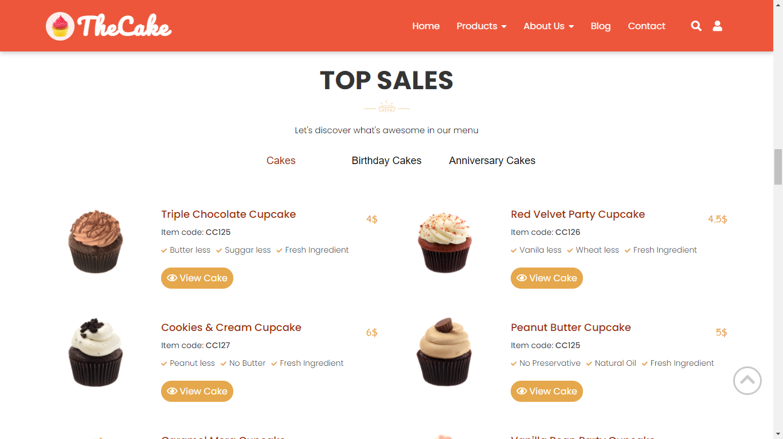
HOME PAGE

Slide 11
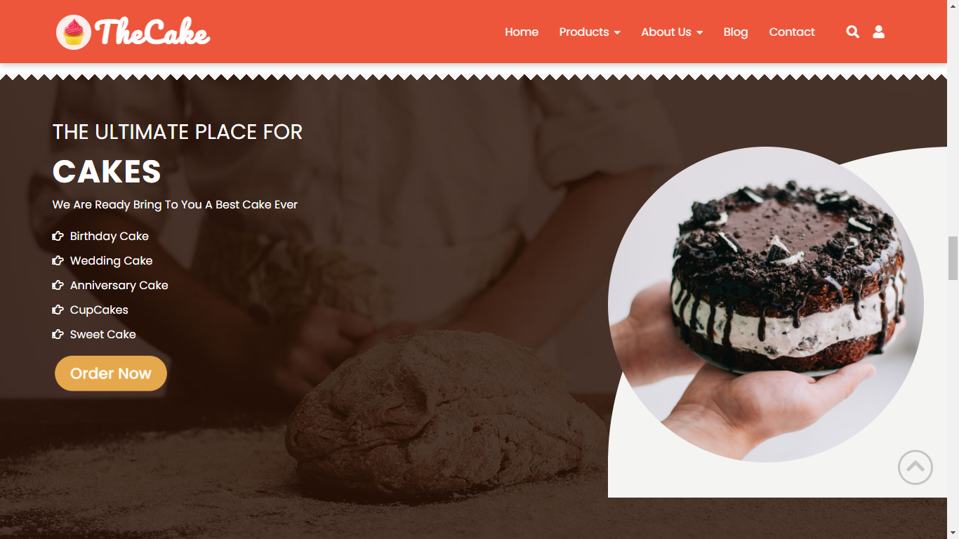
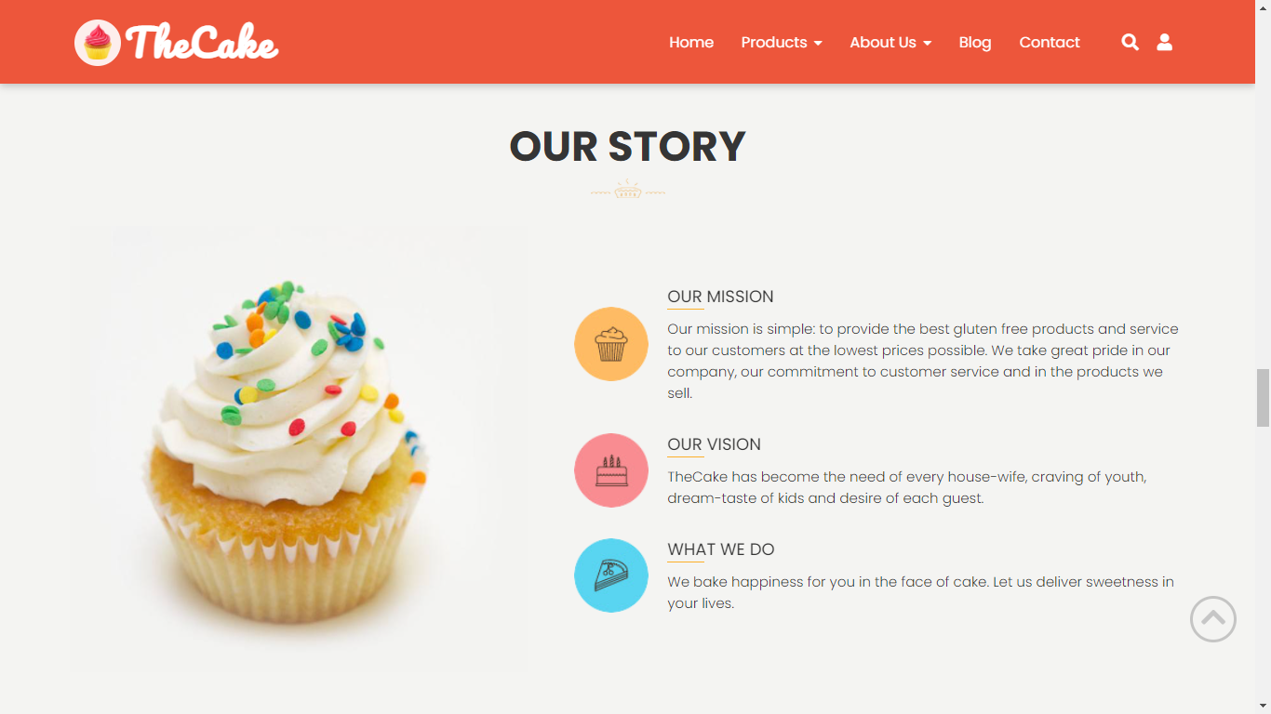
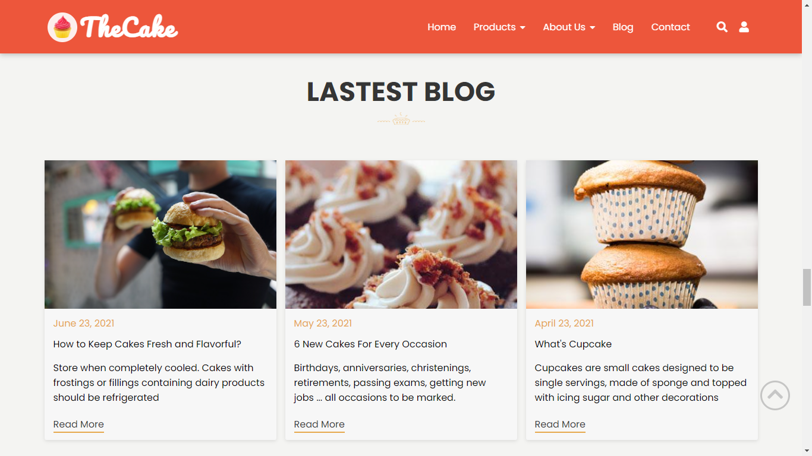
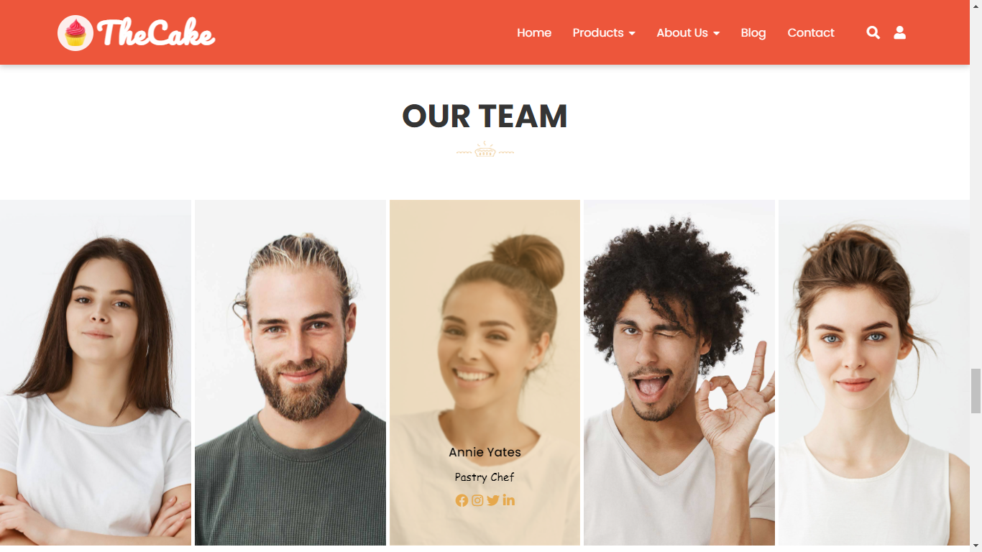
HOME PAGE

Slide 12
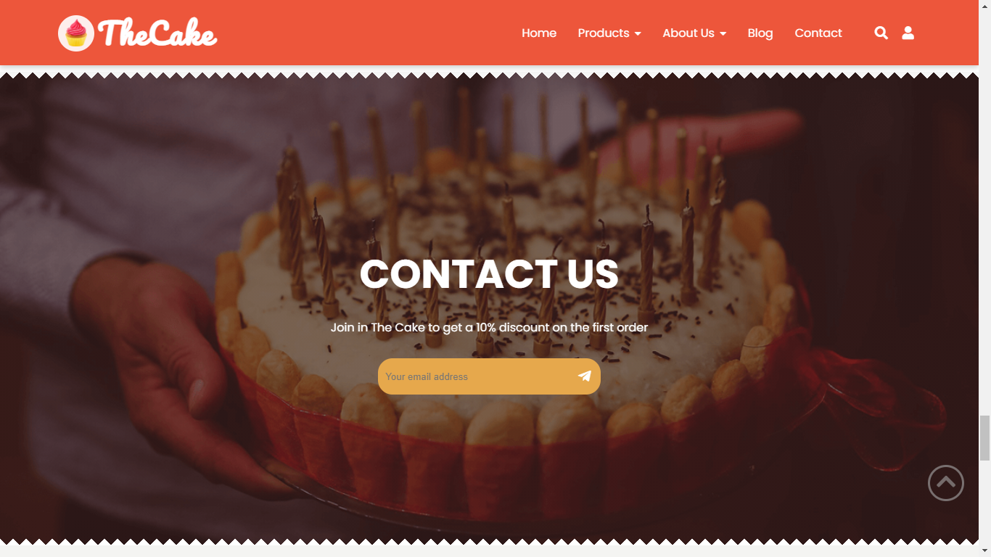
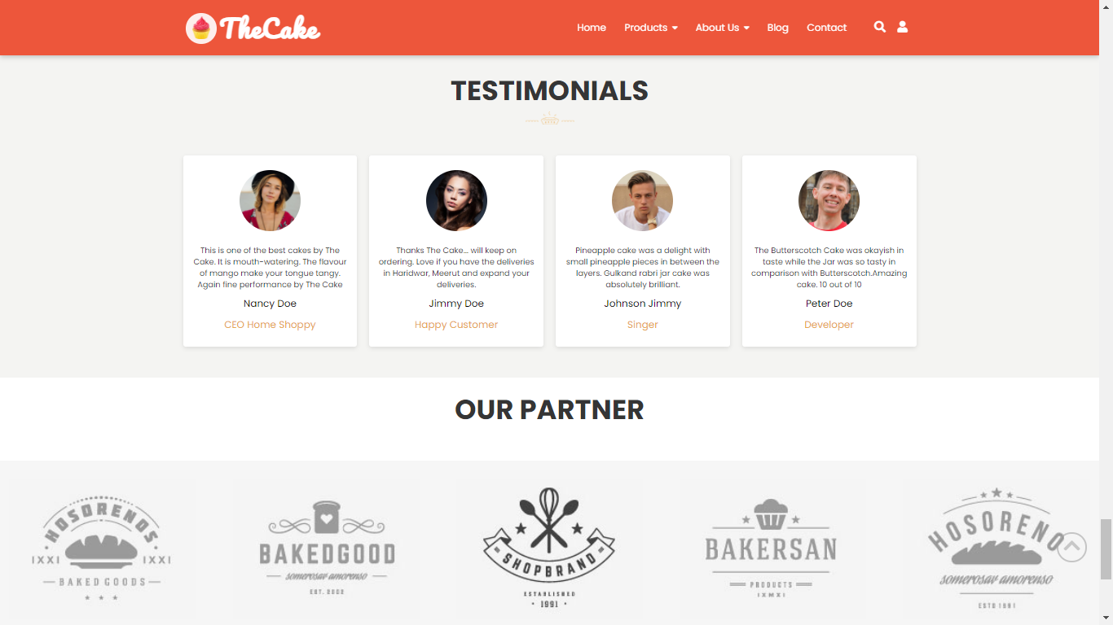
HOME PAGE

Slide 13
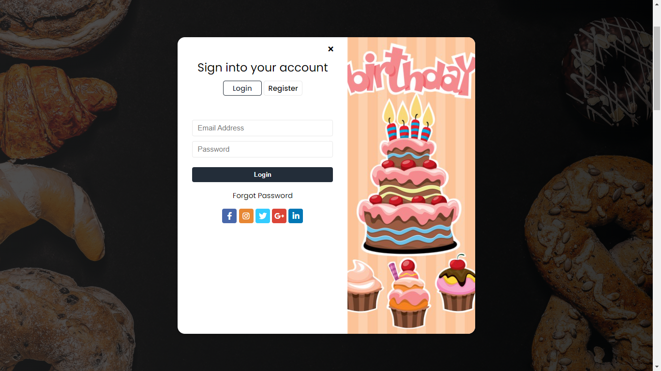
HOME PAGE
In the home page, we build the loggin button on the right of the top website corner to help customer loggin (member) and register as a new member.

Slide 14
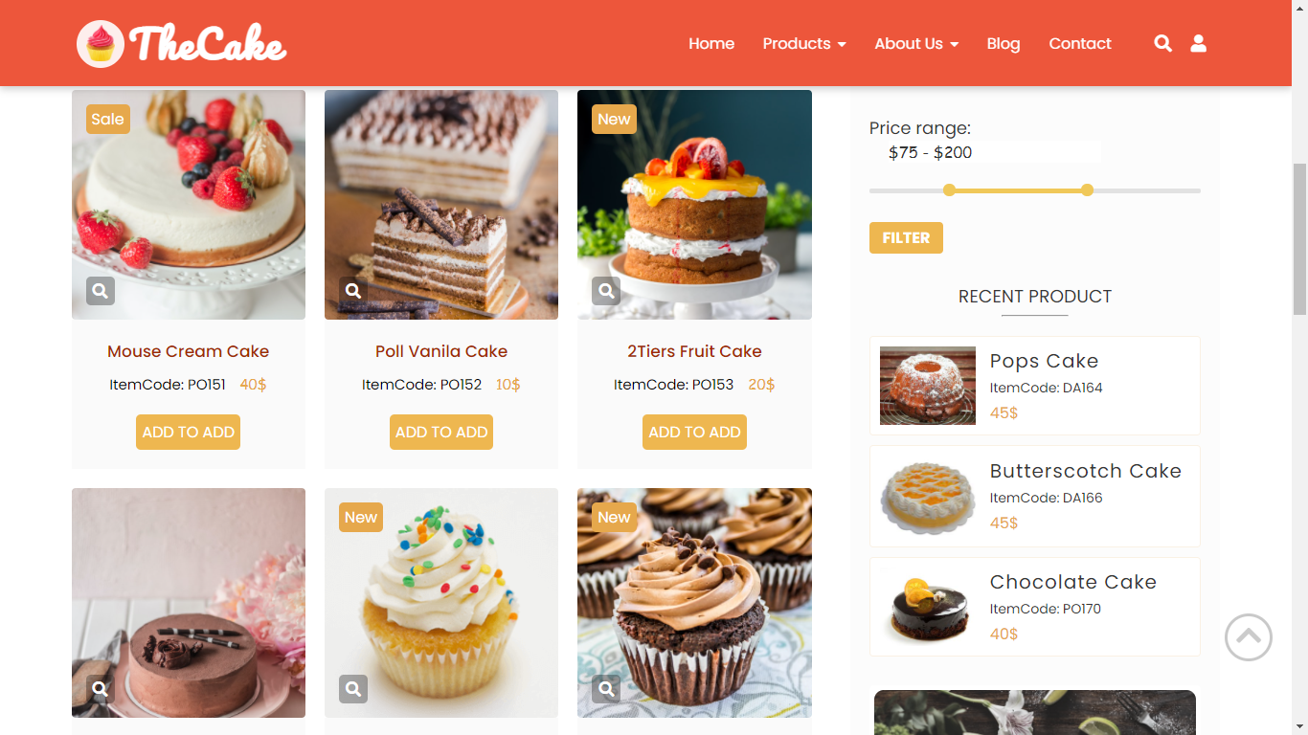
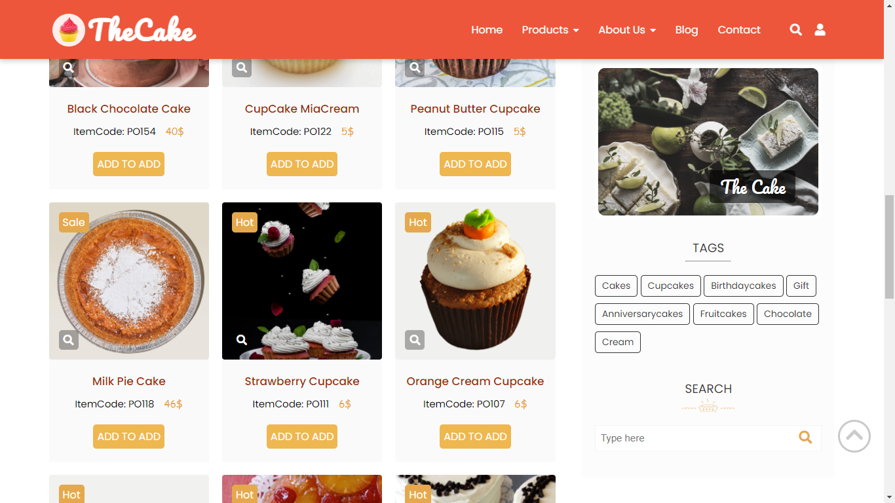
PRODUCT PAGE
We build a product page as the figures below:
We divice 2 section:
On the left are products list with a function click to view bigger size, add to cart and checkout.
On the right are: product filter, product relative, tags and search bar.

Slide 15
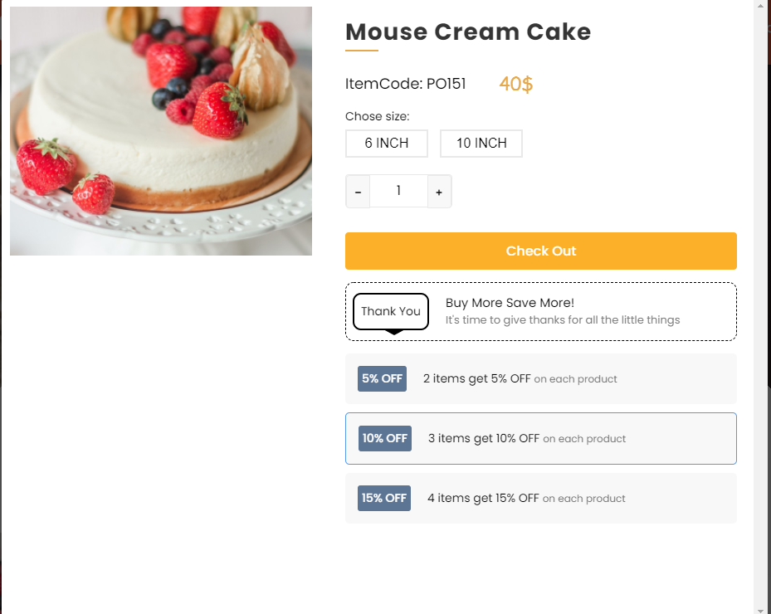
ADD TO CART
When you click on “ADD TO CART” button, will appear as the figures:

Slide 16
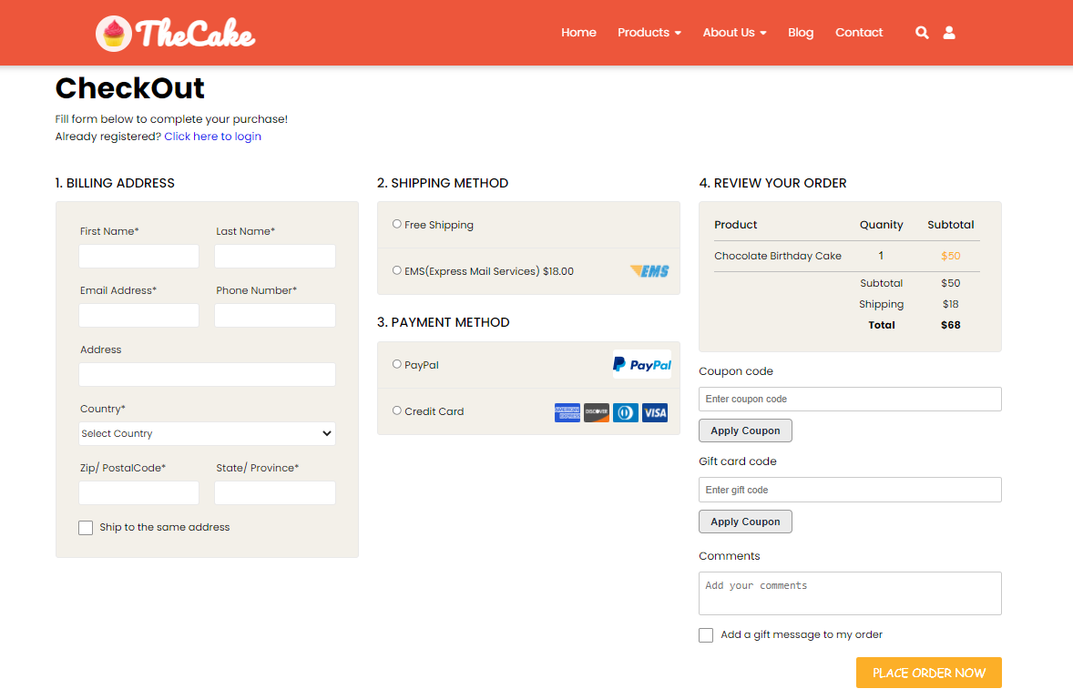
CHECK OUT

Slide 17
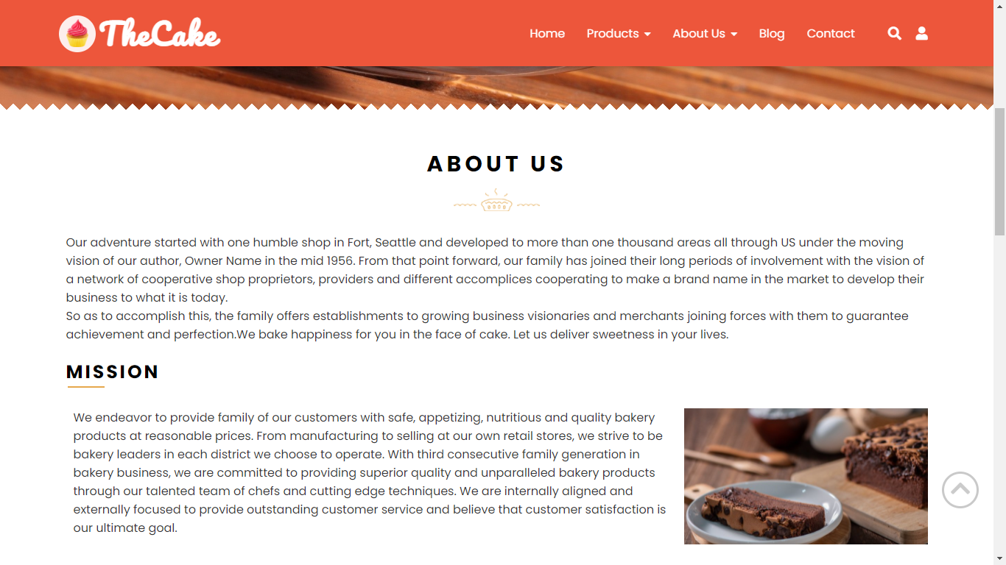
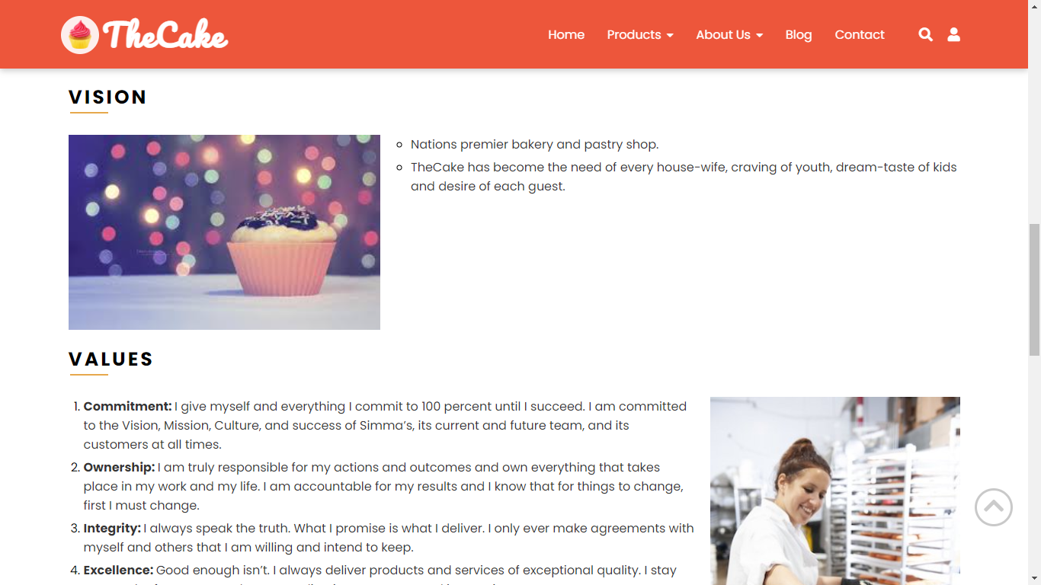
ABOUT US
To tell visitors about our Mission, Vision and Values.

Slide 18
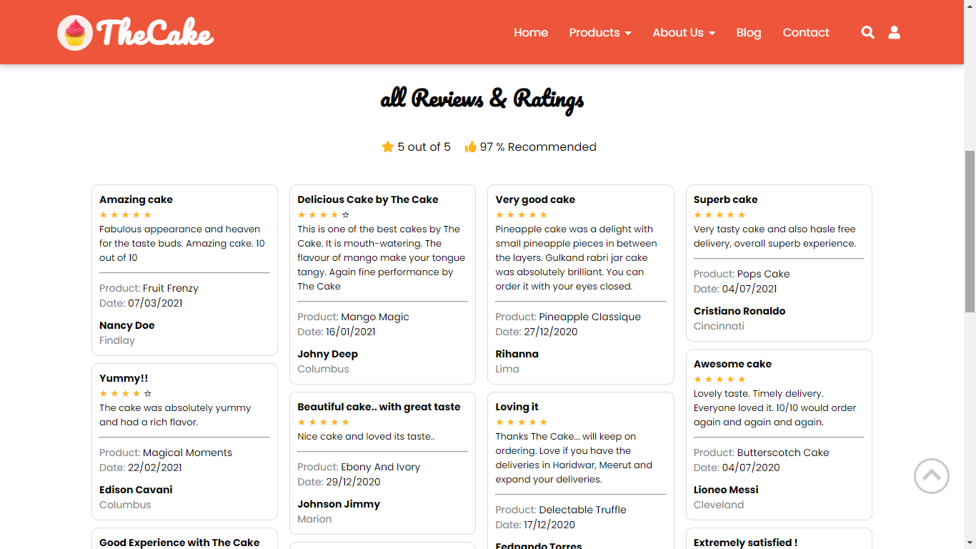
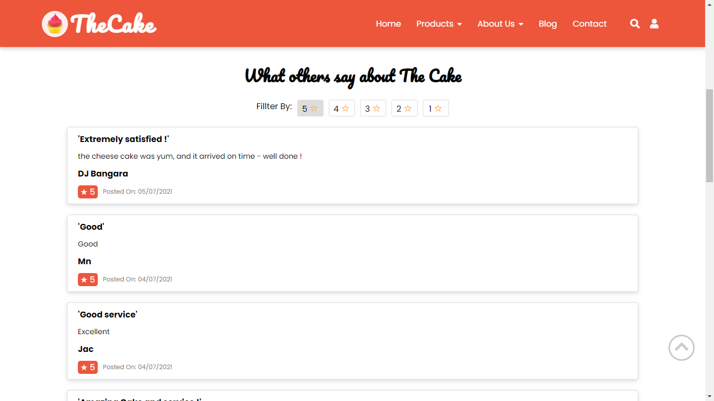
TESTIMONIAL
To tell visitor about: “what customer say about us”, show all review and ratings, and people talk about our products.

Slide 19
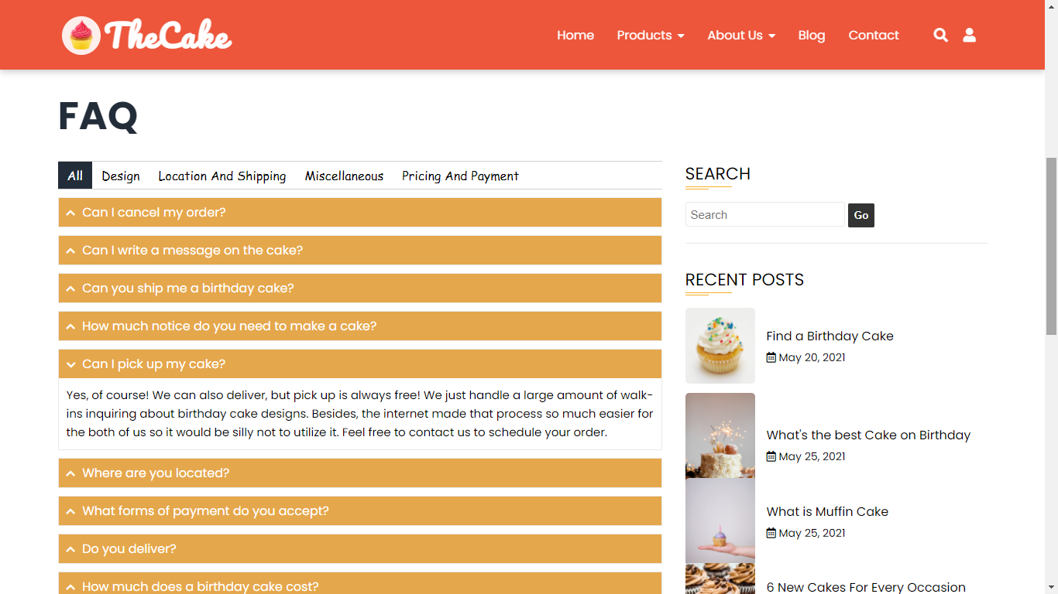
FAQs
To resolve all customer problem as: order, shipping, pricing, billing or customize their cake...

Slide 20
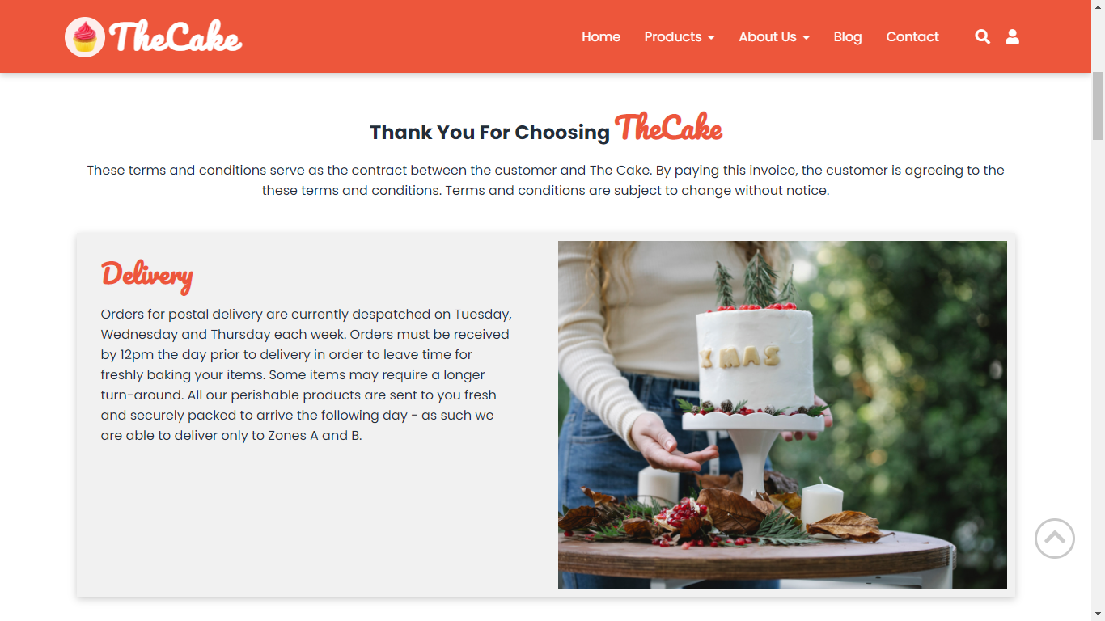
TERM
What’s covered in these terms:
What you can expect from us: which describes how we provide and develop our services.
What we expect from you, which establishes certain rules for using our services

Slide 21
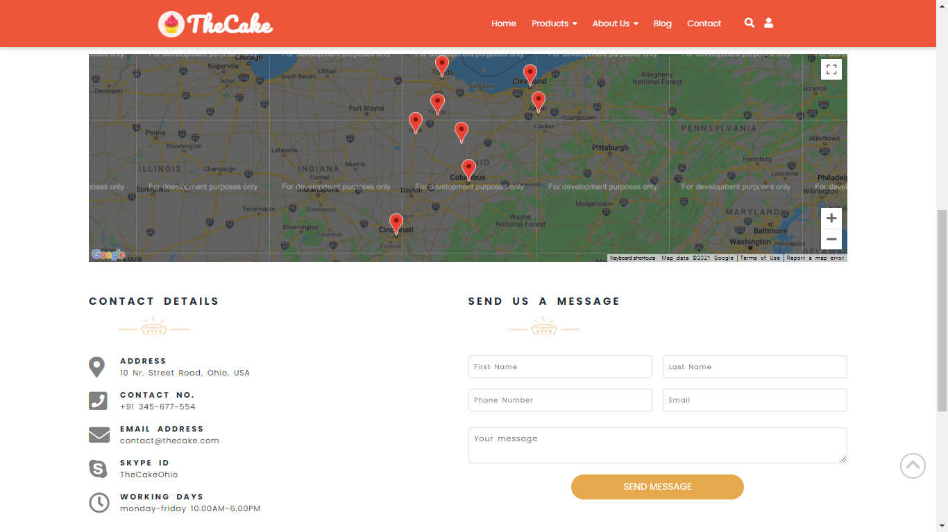
CONTACT US
Show all our store
Contact details
If you need your, please leave your information, we will contact in 1 hours.

Slide 22


